Slide 1
IT2757
Server and Services Security Management
- LINUX ACL and FILE COLLABORATION

Slide 2
Access Control with netfilter
Upon completion of the following 2 units, you should be able to:
  Describe the Netfilter architecture
  Configure packet filtering rules using GUI and CLI tools
  Configure network address translation(NAT) rules
  Filter and disable IPv6 traffic

Slide 3
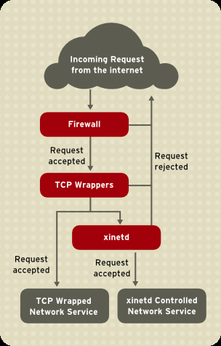
Access Control In UNIX
Firewall and iptables filters out unwelcome network packets within the kernel's network stack.
TCP Wrappers add an additional layer of protection by defining which hosts are or are not allowed to connect to "wrapped" network services. One such wrapped network service is the xinetd superdeamon.
Xinetd is called a superdaemon because it controls connections to a subset of network services and further refines access control.

Slide 4
Firewall
System-config-firewall
Provides a very basic GUI firewall interface
Hides much of the complexity, and functionality, of Netfilter
System->Administration->Firewall
If all you need to do is allow traffic into specific ports for all hosts and deny traffic from anyone else, you can avoid the complexities of the Netfilter command-line interface by using system-config-firewall instead.
This tool controls basic firewall and SELinux settings. For now we will focus on the firewall controls
The first setting one sees on the Firewall Options tab controls whether the firewall is active at all or not. Below that, one may specify ports to allow traffic on. Any enabled port will accept traffic from any hosts. Commonly-used ports are represented by the names of the associated services with checkboxes that can be used to enable or disable them. Below that is an interface for adding non-standard TCP or UDP ports by number.

Slide 5
System-config-firewall
When the firewall is enabled via GUI, the following rules are put into place:
Packets destined for the loopback device(lo) are accepted
Packets destined for an enabled port are accepted from any source
Packets that are responses to the packets you have sent, such as the response to an http request, are accepted
ICMP packets are accepted
Packets destined for a few utility services, such as the CUPS print server, are accepted.
All other packets are rejected with an ICMP “Host Prohibited” message.

Slide 6
System-config-firewall
This configuration may be sufficient in many cases, but Netfilter supports much more finely-tuned configurations, such as accepting or rejecting packets based on the source host or network, which system-config-firewall does not allow for.
If system-config-firewall is executed in a non-graphical environment, or if system-config-firewall-tui is executed instead, a simpler, curses-based interface is presented. This interface can be navigated using the Tab key to move between fields and the spacebar toggle checkboxes and “click” buttons.
The TUI interface even has a feature not present in the GUI interface the ability to designate “trusted” interfaces. If an interface is listed as trusted, all traffic received on that interface is allowed through the firewall.
Do note: Use this feature with caution! Just because a network is internal doesn’t mean that hostile traffic can’t come from it. Sometimes, your internal hosts may be used to attacked your server once the hosts have been hijacked by hackers.

Slide 7
Netfilter Overview
Filtering in the kernel: no daemon
Access policies at layer 2(MAC),3(IP) & 4(TCP/UDP) of the OSI reference Model
Only inspects packet headers
Consists of netfilter modules in kernel, and the iptables user-space software
Filtering occurs in the kernel and at Open System Interconnnection (OSI) Layer “4” and below. It is very fast because only the packet headers are inspected. Inspection of packet contents can be useful for things like tests for protocol correctness, however this usually happens at layers above layer “4 ” , and involve user-space processes.
Most of the packet filtering is provided by Netfilter/IP Tables at layers “3” and “4” (network and protocol). However it can also use the interface (eg. eth0), a layer “2” (data-link) attribute.

Slide 8
The packet filter framework
The packet filter framework on Linux is divided into two parts:
netfilter/Xtables — the kernel-space portion
iptables — the user-space portion
Generally speaking, we tend to refer to them collectively as just “iptables”.

Slide 9
Netfilter 3 Tables and 5 Chains
The filtering framework consists of the 5 built-in chains in kernel space.
The 3 tables reside in user space and hook into the chains. The tables hook into appropriate chains to relate to the role of the rules as follows.
Note: the names of the tables are case-sensitive and are in lower case.
Additional chains (the so-called custom chains) can be created a runtime. The built-in chains are always present, even if, in some cases, they might not be used.

Slide 10
Netfilter Tables and Chains
Table | Role
filter | The main packet filtering is performed in this table
nat | This is where network address translation(NAT)occurs
mangle | This is where a limited number of “special effects” can happen. This table is rarely used
conntrack / raw | This is not user accessible but maintains entries for “stateful” packet inspection. This table uses the PREROUTING and OUTPUT chains

Slide 11
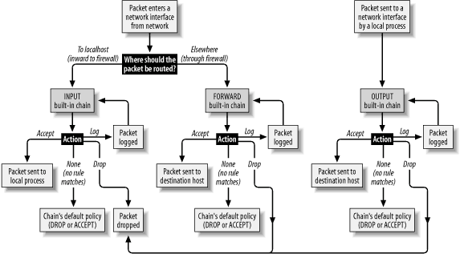
Netfilter Packet Flow

Slide 12
Netfilter Packet Flow using Built-in Chains
Packet filtering takes place within the kernel at the five packet filtering points shown also known as Built-in Chains. Note the filtering points names are case-sensitive and are all in upper case.

Slide 13
Netfilter Packet Flow using Built-in Chains
PREROUTING Chain : This filtering point deals with packets first upon arrival (conntrack , mangle , nat). PREROUTING Chain is present in the conntrack, nat and mangle tables. Packets traverse this chain before a routing decision is made by the kernel.

Slide 14
Netfilter Packet Flow using Built-in Chains
FORWARD Chain: This filtering point handles packets being routed through the local system (mangle, filter). FORWARD Chain is present in the mangle and filter tables. Only packets that neither originate nor terminate at the local host traverse this chain.

Slide 15
Netfilter Packet Flow using Built-in Chains
INPUT Chain: This filtering point handles packets destined for the local system, after the routing decision. INPUT Chain is present in the mangle and filter tables. Only packets terminating on localhost traverse this chain.

Slide 16
Netfilter Packet Flow using Built-in Chains
OUTPUT Chain: This filtering point handles packets after they have left their sending process and prior to POSTROUTING (conntrack, mangle, nat ,filter). OUTPUT Chain is present in the conntrack, nat, mangle and filter tables. Only packets originating on localhost traverse this chain.

Slide 17
Netfilter Packet Flow using Built-in Chains
POSTROUTING Chain: This filtering point handles packets immediately prior to leaving the system (mangle, nat). POSTROUTING Chain is present in the nat and mangle tables. Packets traverse this chain after a routing decision is made by the kernel.

Slide 18
Netfilter Packet Flow using Built-in Chains
Routing Decision: If a packet’s destination address corresponds to the local system then packets are routed to be handled there, by a local process . If the packet is to be delivered to another system, and packet forwarding is enabled in the kernel (see /proc/sys/not/ipv4/ip_forward) the packets are directed in accordance with the routing table.

Slide 19
Rule Matching features in netfilter
Rules in ordered list
Packets tested against each rule in turn
On first match, the target is evaluated: usually exists the chain
Rule may specify multiple criteria for match
Every criterion in a specification must be met for the rule to match(logical AND)
Chain Policy applies if no match

Slide 20
Rule Targets
Built-in tragets: DROP, ACCEPT
Extension targets: LOG, REJECT, custom chain
  Reject sends a notice returned to sender
  LOG connects to system log kernel facility
  LOG match does not exit the chain
Target is optional, but no more than one per rule and defaults to the chain policy if absent
Rule targets determine what action to take when a packet matches the rule’s selection criteria . Target names qualify the –j option of the iptables command(think j as in jump).A target can be built in (Base) target, a custom chain or extension target.
In the netfilter framework, it supports DROP and ACCEPT as the two base targets.

Slide 21
Rule Targets
As with packet matching, additional target capability is added through extensions. Unlike packet matching extension targets are usually implemented in special purpose kernel modules.
For example, the LOG target is implement through the ipt_LOG kernel module. All extension target modules have names starting with ipt_
Most targets do not return that is if a packet matches a rule then checking of that packet ceases(the chain is exited).
Some targets, like LOG do return after the target’s action action has been evaluated, control will pass back to the calling chain. There is, for convenience, a RETURN built in target.
A match in the case of a rule with no target will simply increment a packet and a byte counters associated with that rule. The collection of packet statistics in this manner is probably the only use for rules with no target.

Slide 22
Simple Example
An INPUT rule for the filter table:
iptables –t filter –A INPUT –s 192.168.10.1 –j DROP
In this example , the ‘-A’ is for append, indicating that a single rule will be appended(in this case) to the INPUT chain of the filter table. This rule causes any packet with a source address(hence ‘-s’)of 192.168.10.1 to match and “jump” to it’s target which is DROP, causing the packet to be discarded.
The iptables command provides the user-space door into all the kernel side capabilities of Netfilter. It is used for all rule administration, and is provided on Red Hat Enterprise Linux as part of the iptables RPM package.

Slide 23
Simple Example
[root@stationX ~]# iptables –t filter –A INPUT –s 192.168.10.1 –j DROP
[root@stationX ~]# iptables -L INPUT
Chain INPUT (policy ACCEPT)
Target port opt source destination
DROP all -- station1.example.com anywhere
The above example shows the iptables listing of a rule corresponding to the rule added just before.
NOTE that the rules are in effect immediately!
Note , it was not necessary to specify the filter table in the command (more on that later). The table could have been explicit with –t filter in the command
Our first consideration should be whether our system is mostly open (accepting most packets), or mostly closed (denying most packets).This tendency towards open or closed effects not only rules, but most importantly the chain policy , in effect when no rule matches or is present . The effect is the target for the packet under inspection.

Slide 24
THE END

